Slide 1
Got Love?

Slide 2
Welcome All

Slide 3
Note: After you download the slideshow, you may also need to download some videos from YouTube & add them into this PowerPoint. This tool can help you: Free YouTube Download
We present these messages in outdoor venues using the SonShineTent. Watch the video of our service that goes with this message, click here: http://campaignkerusso.org/?p=8700
We would love to know more about the people who download our lessons & sermons. We invite you to email us & let us know where & how you use them.
info@campaignkerusso.org

Slide 4
Let’s Begin with Prayer

Slide 5
Got Love?

Slide 6
This Slide – Song: Love the Lord Download Here: https://youtu.be/bKVZ_olNkHE

Slide 7
Some Things that are Not Love!
Things that give us pleasure
Things that make us feel cozy

Slide 8
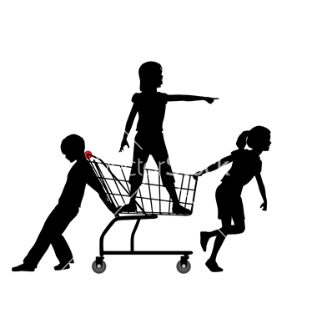
Things that make us feel adored
Things we want to buy

Slide 9
Things that make us feel all gooey inside
Mere Words-
Words-Words-Words

Slide 10
So! What is Love?
Does anyone love me?
Do I love anyone?
Love is
SERVICE!
What (or whom) we love, we will always freely serve!

Slide 11
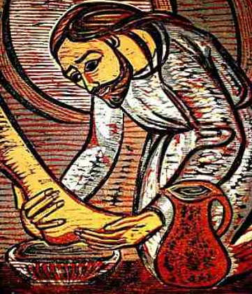
Love Looks Like This
“Even the Son of Man did not come for people to serve him. He came to serve others and to give his life to save many people.” Mark 10:45

Slide 12
And…
Love Looks Like This

Slide 13
Only God Can Truly Love
The rest of us have a real problem loving and serving others more than ourselves.
“Love is not rude, is not selfish, is not always saying, "Me first," and does not get upset with others.” 1 Corinthians 13:5
“Love each other as brothers and sisters and honor others more than you do yourself.” Romans 12:10

Slide 14
Love comes from God and those who know Him can love with His heart.
“…let us love one another, for love comes from God. .. Whoever does not love, does not know God, because God is love.
“This is love: not that we loved God, but that he loved us and sent his Son as a… sacrifice for our sins.” 1 John 4:7-12

Slide 15
With His love in our hearts, we can SERVE each other.
"… Love one another. As I have loved you, so you must love one another.”
John 13:34
“We love because he first loved us.”
1 John 4:19

Slide 16
Jesus Wants Our Love
Even though Jesus has done so much for us… yes, even though He died for us, it is hard for Him to find anyone who loves Him enough to serve Him.
He searches the world for
people who will serve Him.

Slide 17
He looked for someone He could send to talk to people about Him.
“Then I heard the voice of the Lord saying, "Whom shall I send? And who will go for us?"
And I said, "Here am I. Send me!" Isa. 6:8

Slide 18
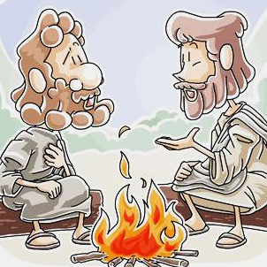
Jesus taught Peter to love Him through service
“If you love me, feed my sheep.”

Slide 19
“This people honors me with their lips, but their heart is far from me”
Mat. 15:8
“They profess to know God, but they deny him by their works.” Titus 1:16

Slide 20
"If you love me, show it by doing what I've told you.”
John 14:15

Slide 22
Is Jesus Speaking
to You?
“They began telling each other how their hearts had felt strangely warm as he talked with them…”
Lk.24:32 (TLB)
John Wesley Said:
“…the preacher was describing the change which God works in the heart… and I felt my heart strangely warmed.”
Jesus makes His presence Known by a small voice!

Slide 23
What is the Sinner‘s Prayer?
This is a prayer we can pray when we are ready to admit we are sinners and need Christ’s forgiveness.
It must be prayed with faith in our hearts and a readiness to have a life-changing encounter with Jesus Christ.

Slide 24
A prayer of faith → Pray this prayer if :
If you never have before
You have in the past, but you think it would mean more today
You have been walking afar off and you want to come back
You want to set an example & show others how it is done
You just like to give your heart to Jesus again & again
Faith

Slide 25
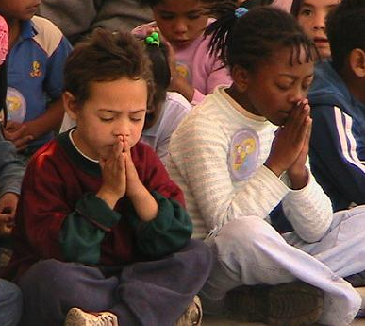
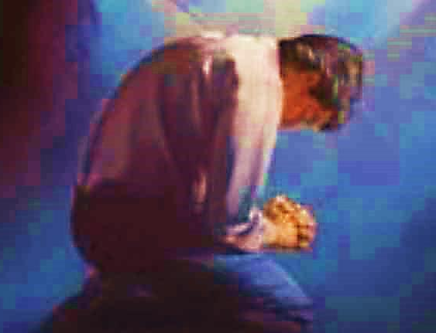
Important Questions
Do you want to know Jesus as your Savior right now?
Do you believe He died to save you from your sins & that He rose from the dead?
Do you believe that He is here, waiting to save you right now?

Slide 26
We Declare Our Faith Publicly Because Jesus Declared His LOVE Publicly
“If you stand before others and are willing to say you believe in me, then I will tell my Father in heaven that you belong to me.” Mat 10:32

Slide 27
The Prayer of a Sinner Turning to Jesus
Dear Jesus, I know that I have sinned against You and that my sins separate me from You.
I am truly sorry.
Right now, I turn away from my sinful past .
Please forgive me, and help me to keep from sin.
I believe You died for my sins.
I Believe You rose from the dead, you are alive, and you hear this prayer from my heart.
I invite You Jesus to be both my Savior and the Lord of my life.
I want You to rule my life from now on.

Slide 28
“But some people did accept him. They believed in him, and he gave them the right to become children of God.”
John 1:12

Slide 30
“If you openly say, ‘Jesus is Lord’ and believe in your heart that God raised him from death, you will be saved.”
Rom. 10:9
What did you learn today?
Tell me about God’s love.
What have you been thinking about God lately?
What do you want to tell the world about Jesus?

Slide 31
This Slide – Song: Love the Lord Download Here: https://youtu.be/bKVZ_olNkHE

Slide 32
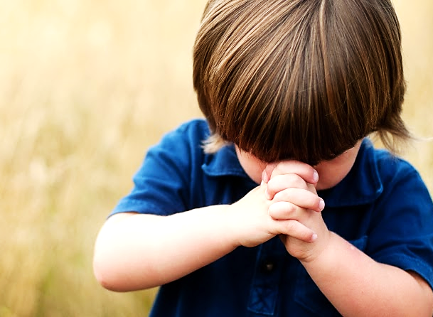
Let’s Close in Prayer

Slide 33
Note: After you download the slideshow, you may also need to download some videos from YouTube & add them into this PowerPoint. This tool can help you: Free YouTube Download
We present these messages in outdoor venues using the SonShineTent. Watch the video of our service that goes with this message, click here: http://campaignkerusso.org/?p=8700
We would love to know more about the people who download our lessons & sermons. We invite you to email us & let us know where & how you use them.
info@campaignkerusso.org

